Slide 1

PBL Presentation
Text analysis using pretrained models for hate speech detection
Rushi Parhad, Sharvayu Zade, Mukund Kuthe
PBL Group No:29
Sem: IV
Under the guidance of
Dr. Deepak Suresh Asudani
Symbiosis Institute of Technology, Nagpur Campus

Slide 2


Innovative Practices & Quality Initiatives at SIT-N
01
Problem Statements
Aim and Objectives
Presentation Flow
Models used
Model Performance
Conclusion
02
04
Literature Review
Methodology Overview
Dataset Description
Preprocessing and feature Engineering
03

Slide 3

Problem Statement: Introduction
With the rise of social media, hate speech and abusive content have become a major concern online. This project aims to build a machine learning-based system to automatically detect hate speech in text using vectorization techniques like CountVectorizer and TF-IDF. We applied and compared multiple ML models on two public datasets to evaluate performance and improve online content moderation.

Slide 4
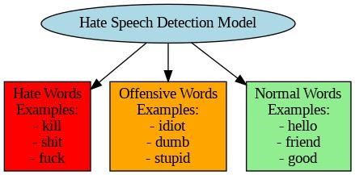
Aim & Objectives
Aim: Automate detection of hate speech using feature extraction + ML classifiers
Objectives:
Use CountVectorizer & TF-IDF for vectorization
Apply ML algorithms: XGBoost, kNN, etc.
Evaluate with two datasets
Compare model performance using accuracy
04
Fig: Hate Speech Detection and Word Classification

Slide 5
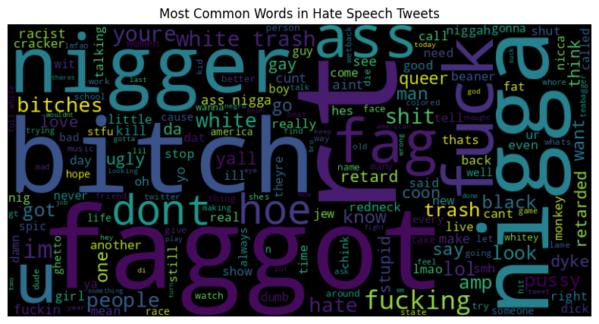
Literature Review
Early approaches to hate speech detection used traditional machine learning models like SVM and Logistic Regression with manually crafted features such as slurs and hashtags. These methods had limitations in capturing sarcasm and contextual meaning. With the emergence of deep learning, models like CNNs and RNNs, along with word embeddings like Word2Vec and GloVe, enhanced detection by learning deeper semantic patterns.
Transformer-based models such as BERT, HateBERT, and BERTweet brought significant improvements by understanding context and implicit hate. However, these models demand high computational resources and large labeled datasets. Recent research also emphasizes the need for explainability and ethical handling of hate speech detection systems.
04
Fig.1. Most common words in Hate Speech Tweets

Slide 6
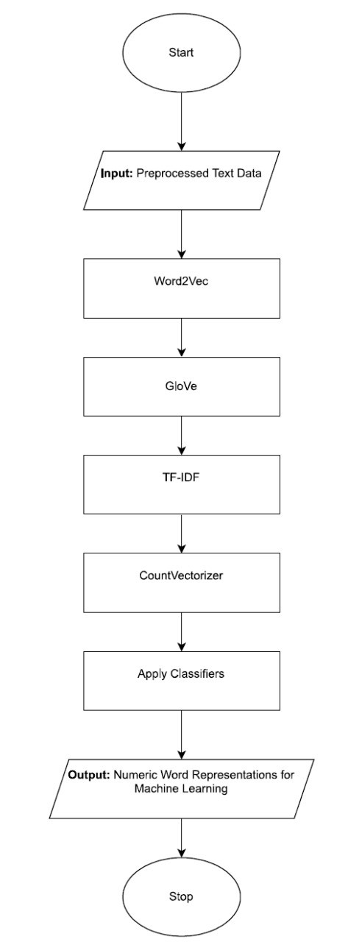
Methodology Overview
Preprocessing:
Removed URLs, mentions, and punctuation
Converted text to lowercase
Applied lemmatization and removed stopwords (excluding negations)
Vectorization Techniques:
TF-IDF and CountVectorizer for frequency-based features(word frequencies)
Word2Vec and GloVe for semantic word embeddings.(relationships between signs and symbols)
Handling Class Imbalance:
SMOTE for synthetic oversampling
Class weighting in algorithms like XGBoost
Modeling:
Implemented ML models: Naive Bayes, Decision Tree, kNN, SVM, Random Forest, Logistic Regression and XGBoost
Hyperparameter tuning with XGBoost for best performance
04
Fig: Workflow of approach towards the Model

Slide 7
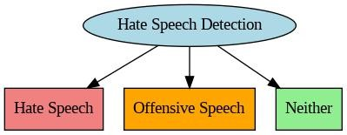
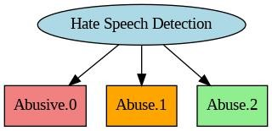
Dataset Description
Dataset 1: Hate Speech Data
Tweets labeled as Hate (0), Offensive (1), Neutral (2)
Dataset 2: ConvAbuseEMNLP
Dialogues with abuse annotations (binary/multilabel)
Realistic conversational AI context
Dataset 1: Hate Speech Data
Dataset 2: ConvAbuseEMNLP

Slide 8
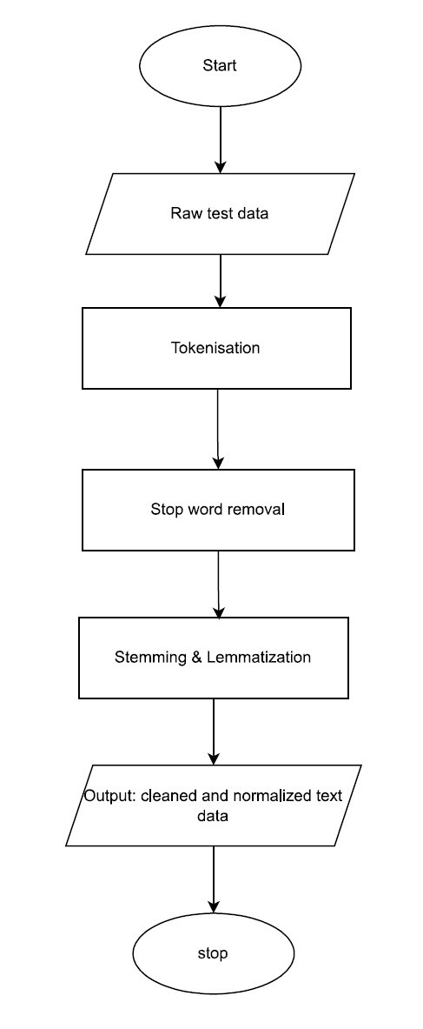
Preprocessing & Feature Engineering
Preprocessing & Feature Engineering
Text Preprocessing:
Used regular expressions to remove URLs, mentions, and non-alphabetic characters
Applied lemmatization for word normalization
Removed standard stopwords (negations like "not", "never" were retained)
Feature Extraction:
Used TF-IDF and CountVectorizer with:Top 2000 most frequent terms
Handling Class Imbalance:
SMOTE: Synthetic Minority Oversampling Technique to balance classes
XGBoost: Used scale_pos_weight to penalize misclassified minority classes
Fig: Feature Engineering and Preprocessing

Slide 9
Machine Learning Models Implemented
Model | Description
Naïve Bayes (GaussianNB) | Probabilistic classifier assuming feature independence.
Decision Tree (Entropy) | Tree-based model using entropy to split nodes.
K-Nearest Neighbors (k=5) | Non-parametric algorithm that classifies based on the closest neighbors.
Logistic Regression | Linear classifier that models the probability of binary outcomes.
Random Forest (10 trees) | Ensemble of decision trees using entropy-based splitting.
Support Vector Machine (SVM) | Finds optimal hyperplane for maximum class separation.
XGBoost | Optimized gradient boosting technique that builds additive trees iteratively with regularization for better generalization. Efficient and high-performing on tabular data.

Slide 10
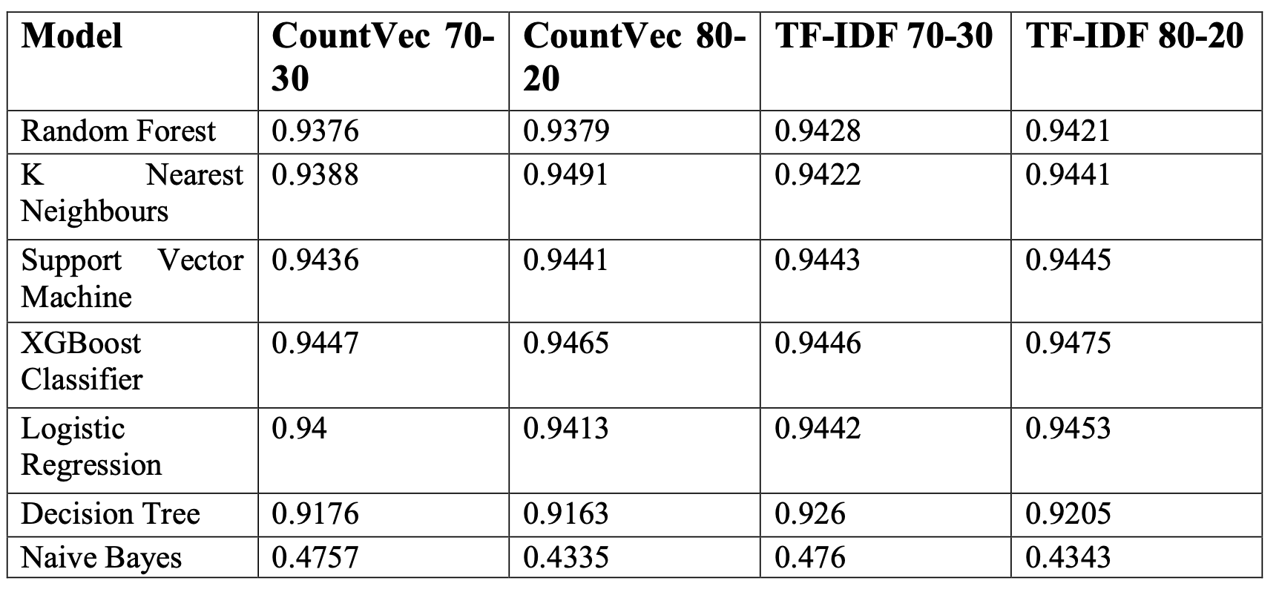
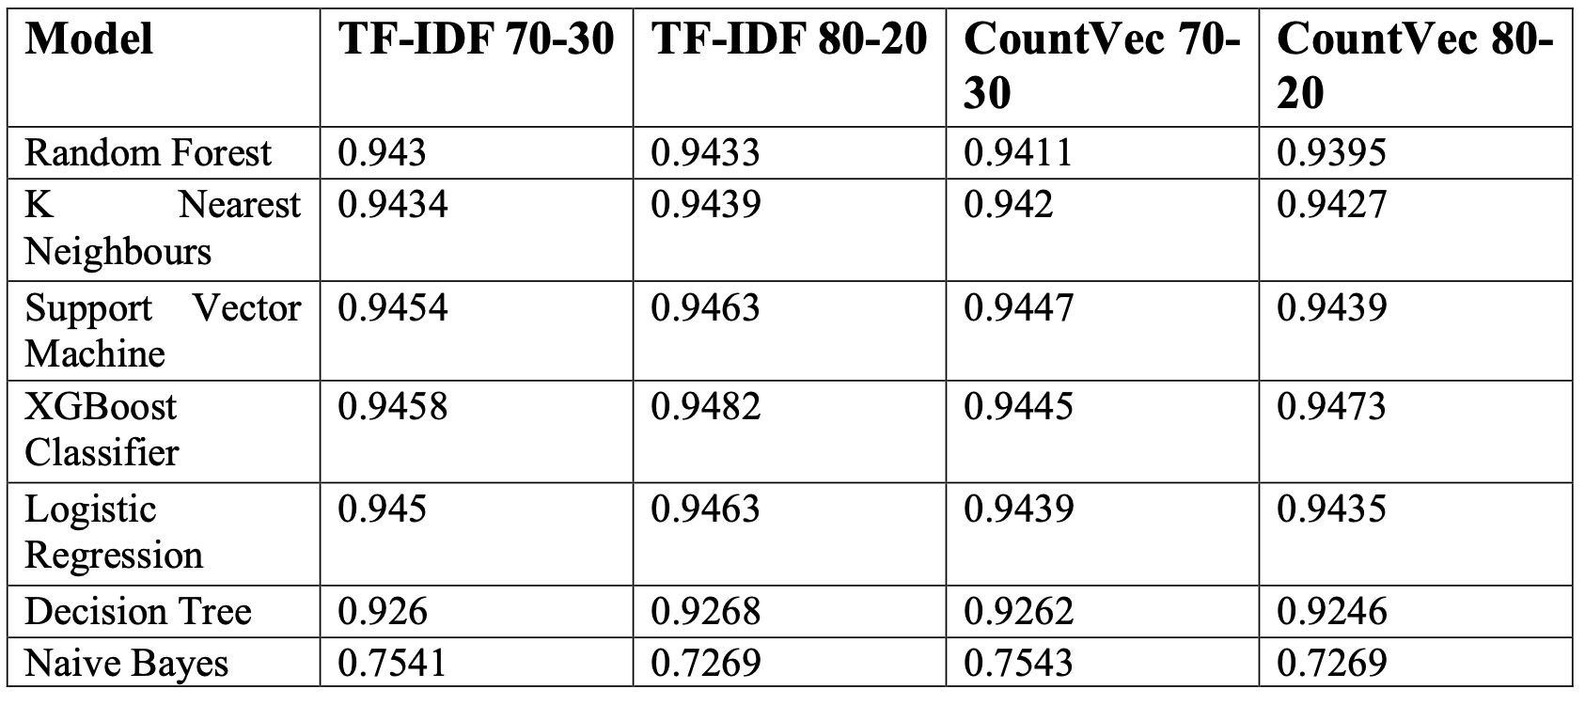
Model Performance – Hate Speech Dataset
XGBoost (TF-IDF, 80-20): 94.75%
SVM, Logistic Regression: ~94.5%
CountVectorizer performance slightly lower
SMOTE improves accuracy across models
04
Dataset 1: Hate Speech Data Without Smote
Dataset 1: Hate Speech Data With Smote

Slide 11
Model Performance – Hate Speech Dataset
Result
SMOTE has marginal effect on already strong classifiers like XGBoost and SVM.
Naive Bayes benefits dramatically, showing a ~+30% performance boost.
TF-IDF with 80-20 split continues to yield top results across models.
The dataset appears to be relatively balanced, limiting the impact of SMOTE for most algorithms.
Aspect | Without SMOTE | With SMOTE
Overall Accuracy | Very high (~0.94+) | Slight improvements in some models
Top Performing Model | XGBoost Classifier (TF-IDF 80-20) – 0.9475 | XGBoost Classifier (TF-IDF 80-20) – 0.9482
Support Vector Machine | ~0.9445 best (TF-IDF 80-20) | Slightly improved to 0.9463
Naive Bayes | Performs poorly (~0.43–0.47) | Significant improvement (~0.72–0.75) with SMOTE
Effect of SMOTE | Minimal for most models due to balanced nature | Most beneficial for Naive Bayes
Best Vectorizer | TF-IDF consistently outperforms CountVec | Still remains the best overall
04

Slide 12
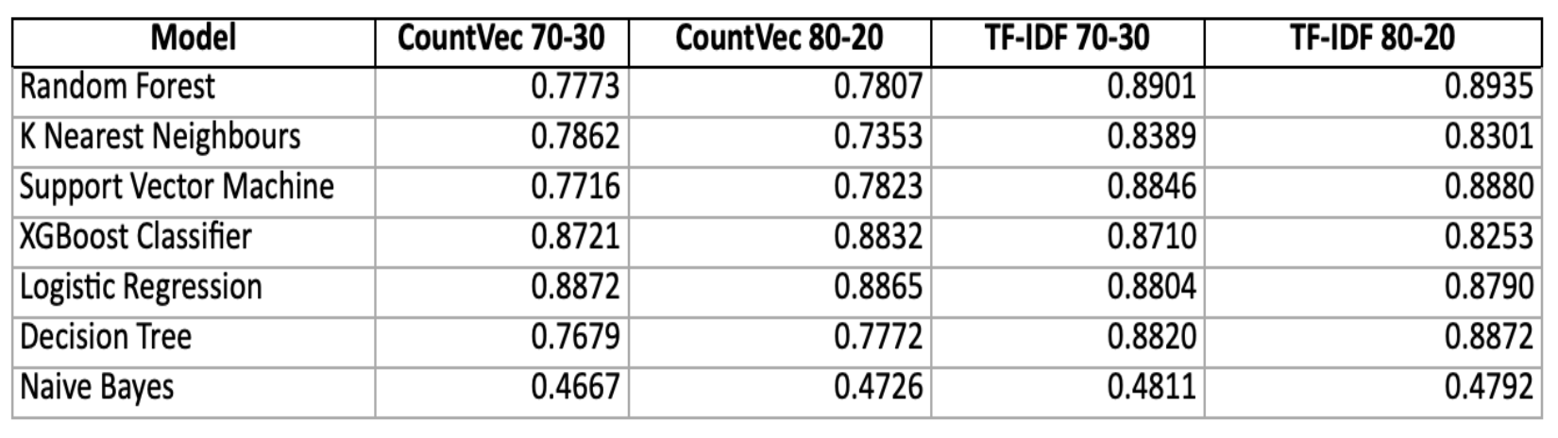
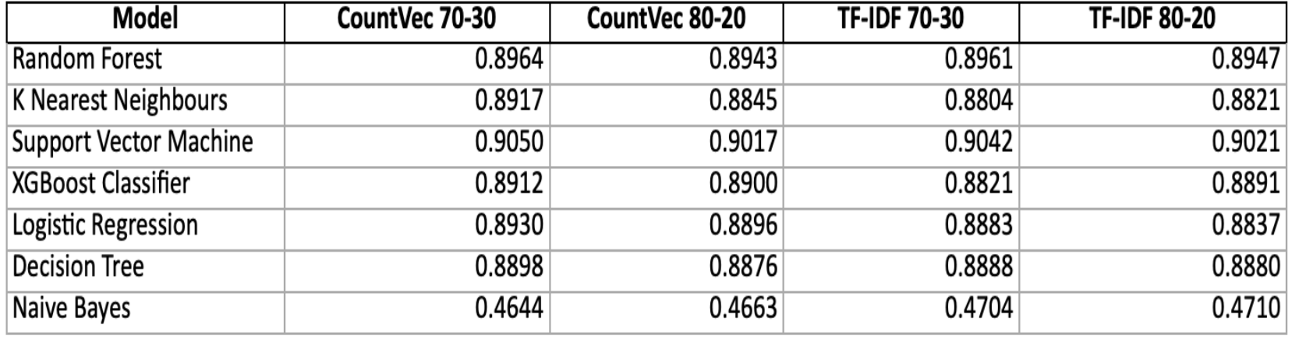
Model Performance – ConvAbuseEMNLP
TF-IDF outperforms CountVectorizer
SVM best performer without SMOTE
Naive Bayes underperforms consistently
SMOTE impact varies; may cause overfitting in some models
04
Dataset 2: ConvAbuseEMNLP Without Smote
Dataset 2: ConvAbuseEMNLP With Smote

Slide 13
Model Performance – ConvAbuseEMNLP
Result
SMOTE application noticeably improved performance for most models, especially SVM and Decision Tree.
Support Vector Machine and Logistic Regression show the most benefit from oversampling.
Naive Bayes remains an underperformer regardless of balancing technique.
Aspect | Without SMOTE | With SMOTE
Overall Accuracy | Varies across models; top ~0.88 | Significantly improved; top ~0.90
Top Performing Model | Logistic Regression (TF-IDF 70-30) – 0.8804 | Support Vector Machine (CountVec 70-30) – 0.9050
Naive Bayes | Performs poorly across all setups (~0.47) | Still underperforms, minimal impact from SMOTE
CountVec Models | Lower than TF-IDF in most cases | Performance improved to be on par with TF-IDF
TF-IDF Models | Consistently higher accuracy | Maintained or slightly improved with SMOTE
Best Split | 70-30 gives better results than 80-20 in most cases | Slightly better results with 70-30 split as well
04

Slide 14
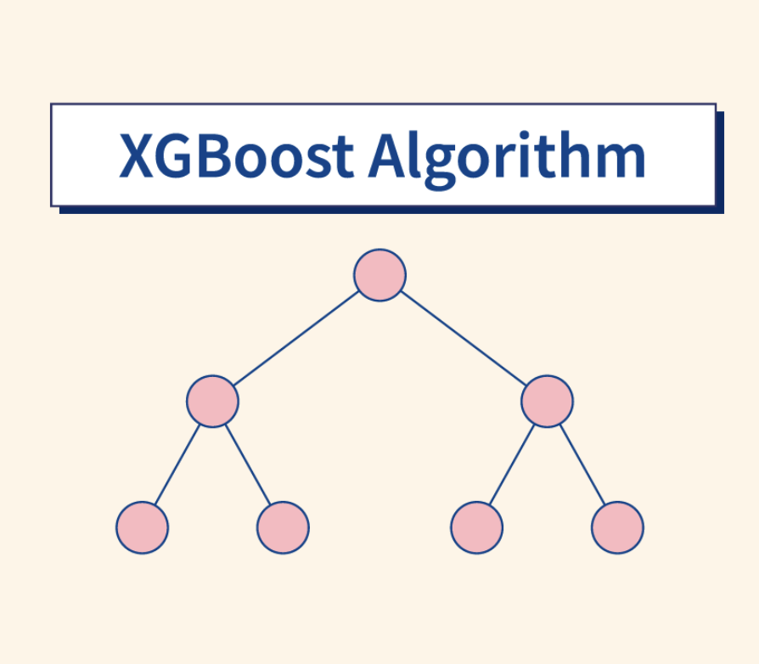
Final Model – XGBoost
Why XGBoost? The Best Performing Model
Model Benchmarking Overview
Compared 7 models: Logistic Regression, Naive Bayes, SVM, Random Forest, KNN, Decision Tree, and XGBoost
Evaluation Metrics: Accuracy, Precision, Recall, F1-Score
XGBoost Outperformed All
Accuracy: 85%
Precision: 84%
Recall: 82%
F1-Score: 83%
Why Chose XGBoost?
Handles imbalanced data effectively
Strong regularization prevents overfitting
Efficient with high-dimensional and sparse features (e.g., TF-IDF)
Final Choice
XGBoost was selected as the core model for hate speech detection due to its superior performance and robustness across all evaluation metrics.
04

Slide 15
Hyperparameters Choices & Justifications
Parameter | Why Used? | Alternatives Not Used
learning_rate (0.01–0.3) | Small steps prevent overfitting, to balance convergence speed and precision. | Fixed LR (e.g., 0.1): Less adaptive to dataset specifics.
n_estimators (100–1000) | Balances underfitting (too few trees) vs. overfitting (too many). | Default (100): Often suboptimal for complex text data.
max_depth (3–10) | Controls tree complexity; deeper trees risk overfitting on noisy text. | Unlimited depth: Leads to overfitting on rare hate speech patterns.
min_child_weight (1–5) | Prevents overfitting by requiring minimum samples in leaf nodes. | Default (1): Less robust for imbalanced classes.
gamma (0–0.5) | Regularization to prune irrelevant splits (critical for high-dim TF-IDF). | default (gamma=0): No penalty for splits, risking noise amplification.
subsample/colsample | Randomly subsets data/features to improve generalization. | Always using 100%: Higher variance in predictions.
reg_alpha/reg_lambda | L1/L2 regularization to handle sparse text features. | No regularization: Risk of overfitting to training set.
scale_pos_weight (0.5–2) | Adjusts for class imbalance (hate speech is typically rare). | No weighting: Minority class (hate) may be ignored.
early_stopping_rounds=50 | Stops training if validation score plateaus (prevents overfitting). | No early stopping: Wastes time and risks overfitting.
04

Slide 16
Conclusion and Future Scope
Conclusion:
In conclusion, the hate speech identification system effectively demonstrates that traditional machine learning models, when combined with proper preprocessing and feature extraction techniques, can perform well in classifying conversational text data. The use of CountVectorizer and TfidfVectorizer for vectorization, along with the SMOTE technique for handling class imbalance, significantly improved the model's accuracy, particularly for the minority class. Among the seven models tested, XGBoost emerged as a strong contender for practical applications due to its robust performance. This study emphasizes that even relatively simple models can yield high accuracy in binary hate speech detection when supported by thoughtful preprocessing and data balancing strategies. The choice of vectorization and class balancing method plays a critical role in determining the overall model success.
Future Scope:
While the current approach provides a strong foundation for hate speech detection using traditional machine learning, there is ample room for improvement. Future work can explore advanced models like BERT and other transformer-based architectures to better capture contextual meaning. Additionally, integrating multilingual support can enhance the system's applicability across diverse languages and global contexts.

Slide 17
Summary
04

Slide 18

04

